Slide 1

REPORT ON REAL ESTATE PREDICTIONS
By Shaily Antala
UIT-IBM

Slide 2
INTRODUCTION
The global economy heavily depends on the real estate sector, and forecasting property values accurately is essential for all parties involved—buyers, sellers, homeowners, investors, developers, shareholders, and legislators, among others. Investment and valuation in the property market have consistently been crucial for both the residential and commercial sectors. By providing a beneficial understanding of the state of the market, statistical modeling approaches help investors foresee trends and make intelligent choices. In order to create predictive models to estimate the cost of properties, we examine a large-scale real estate dataset in this report.

Slide 3
PROBLEM STATEMENT
Property values are influenced by a wide range of factors, making the marketplace for real estate intrinsically complicated. Conventional techniques for valuing real estate frequently depend on opinions and past patterns, which could not accurately represent the actual state of the market. In addition, the real estate market is changing so quickly that more advanced, data-driven methods of value predicting are required. The difficulty is in creating a model with predictive abilities that can reliably estimate prices for a range of properties in a variety of markets and locations while also precisely capturing the subtleties of the property market as a whole.

Slide 4
OBJECTIVE
The creation of precise residential land cost estimation algorithms is the main goal of this investigation. In particular, the objectives are:
To investigate and comprehend the features of the housing dataset.
To determine the essential elements that affect the value of property.
To manage values that are missing, abnormal values, and categorical variables during the preprocessing of the data.
To create and assess models based on machine learning for predicting property values.
To analyze the models and extract useful information for the leasing industry stakeholders.

Slide 5
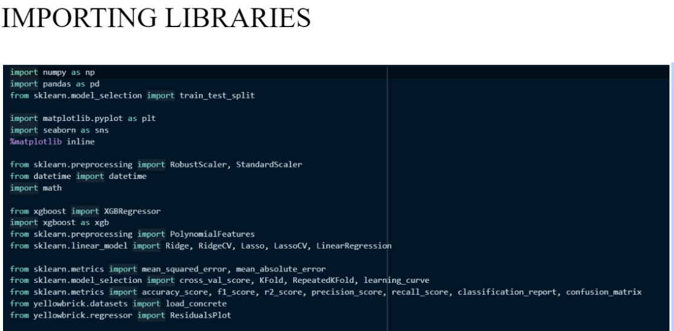

Slide 6
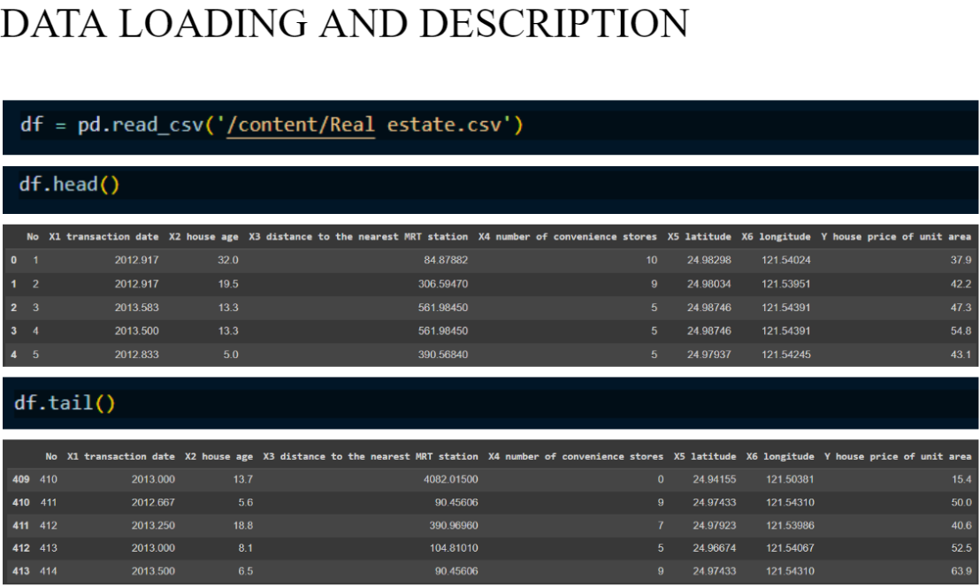

Slide 7
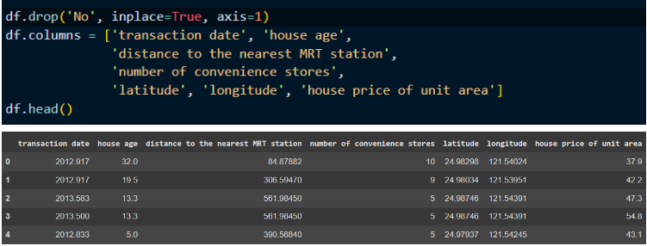

Slide 8
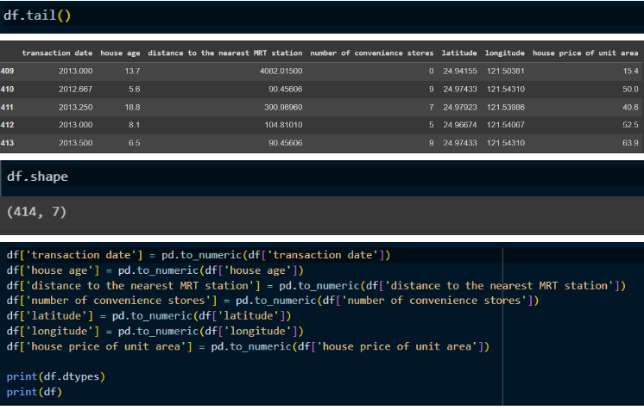

Slide 9
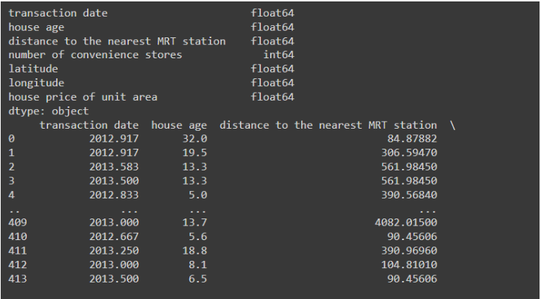

Slide 10
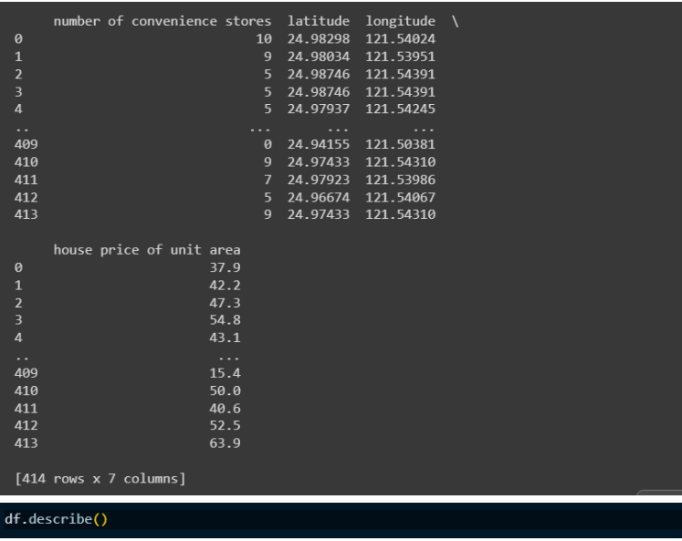

Slide 11
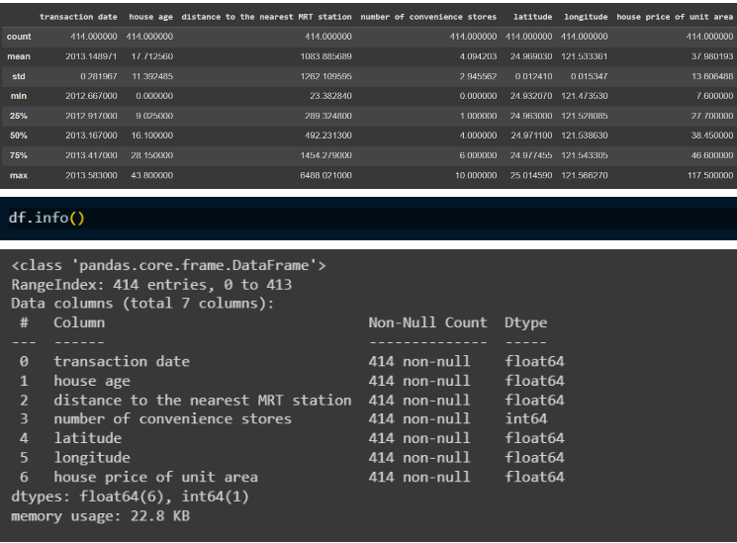

Slide 12
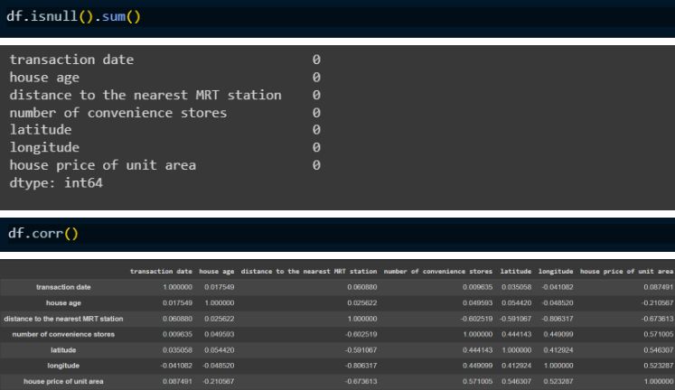

Slide 13
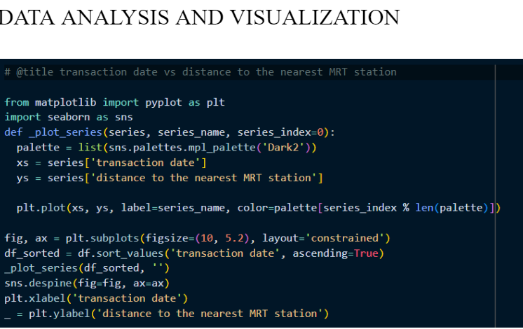

Slide 14
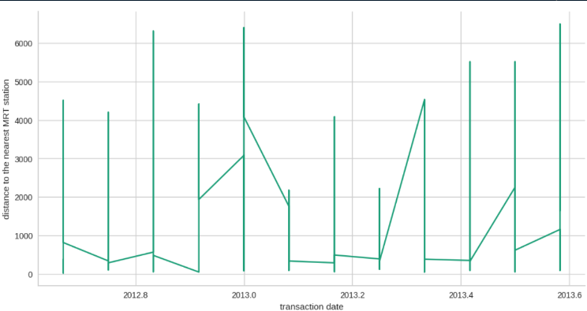

Slide 15
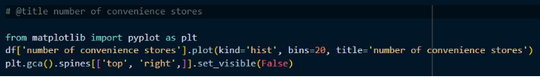
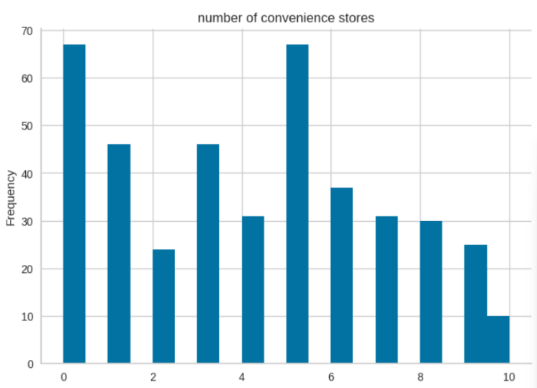

Slide 16
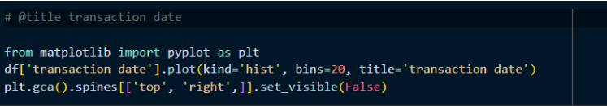
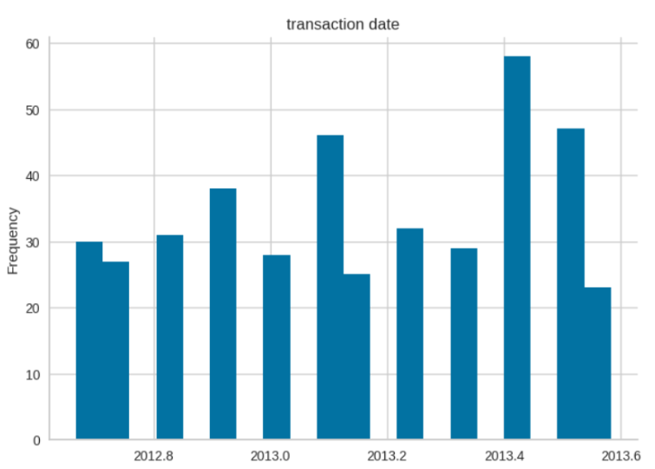

Slide 17
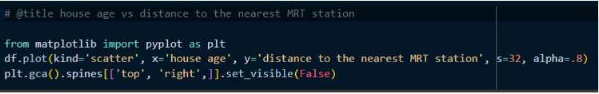
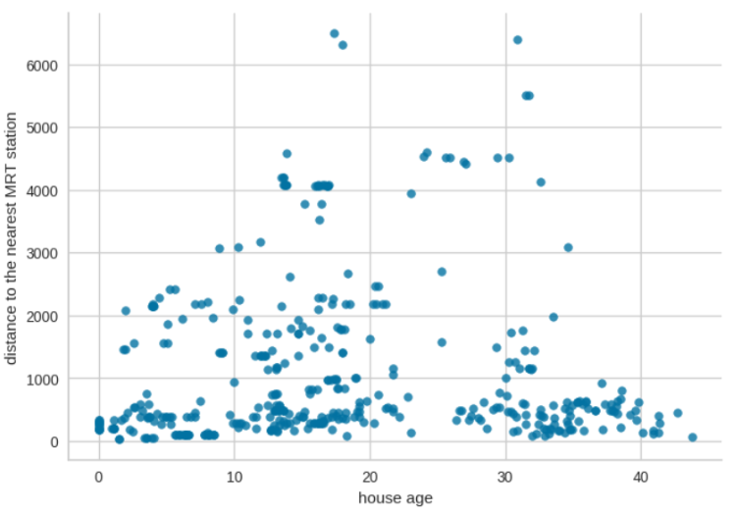

Slide 18
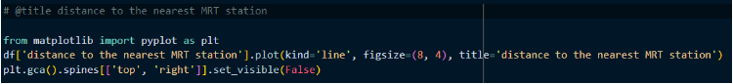
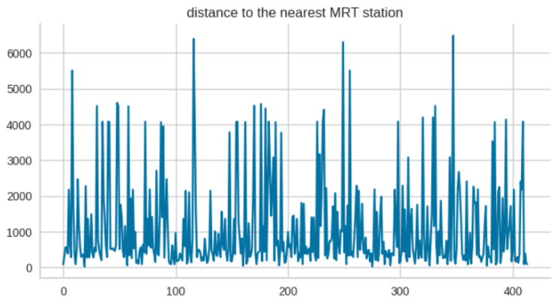

Slide 19
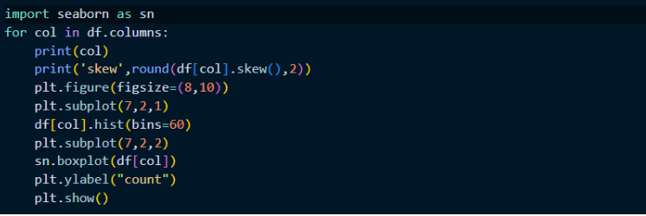

Slide 20
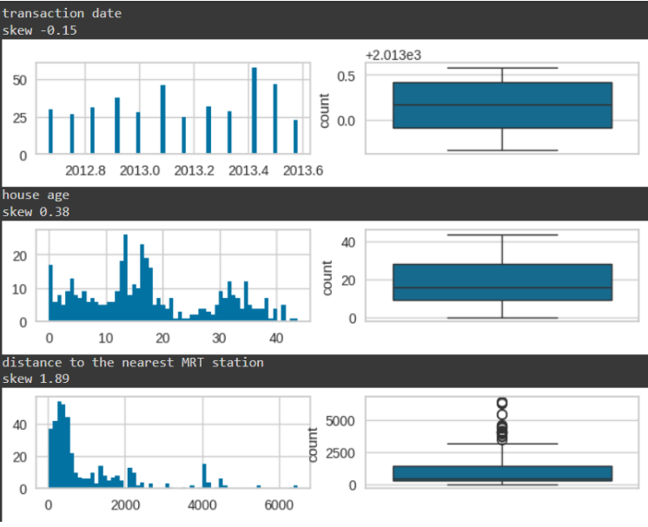

Slide 21
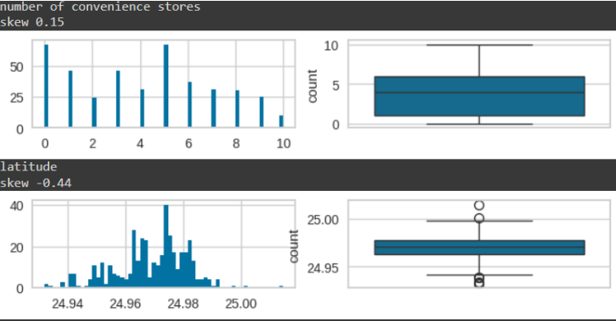

Slide 22
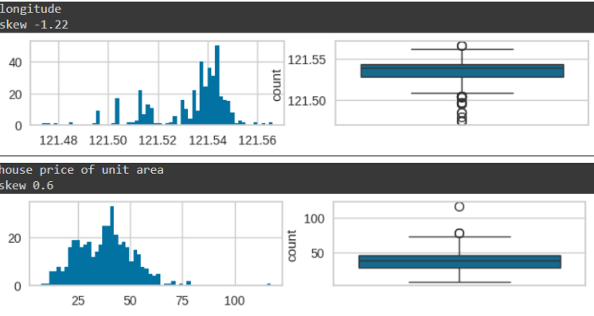

Slide 23
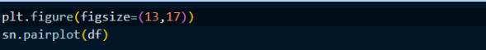
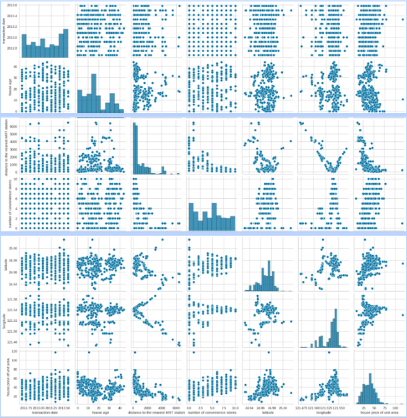

Slide 24
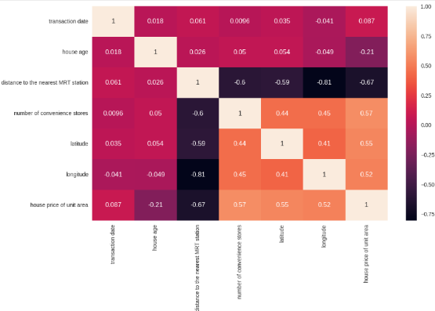

Slide 25
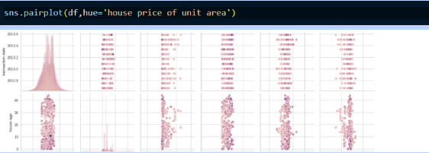
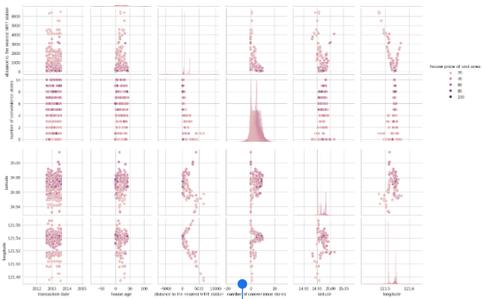

Slide 26
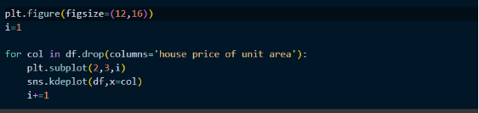

Slide 27
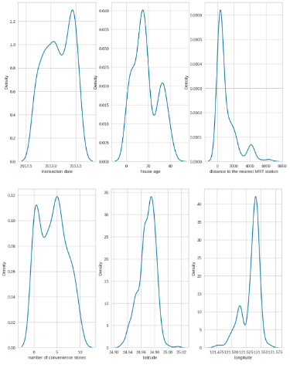

Slide 28
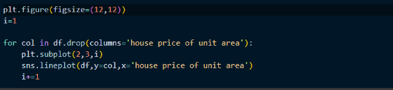

Slide 29
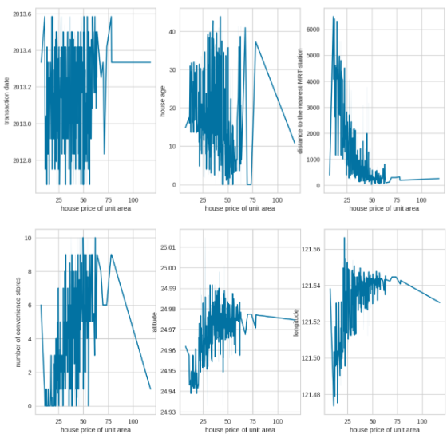

Slide 30
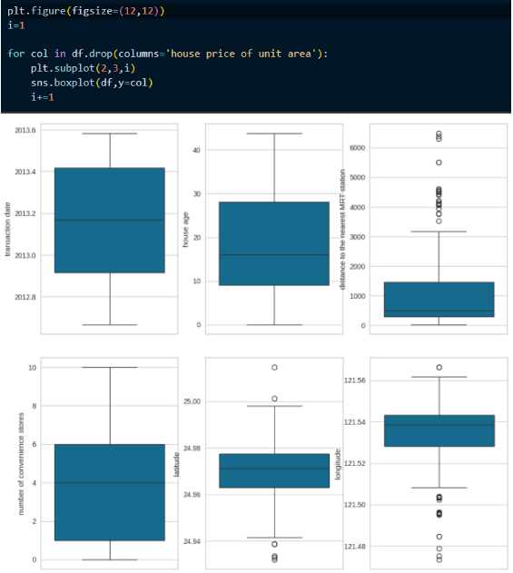

Slide 31
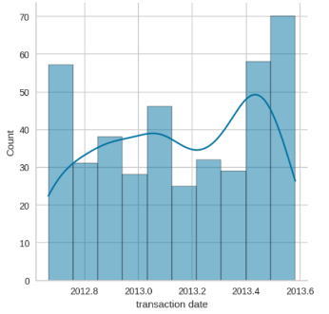

Slide 32
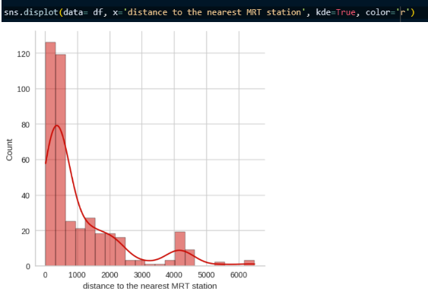

Slide 33
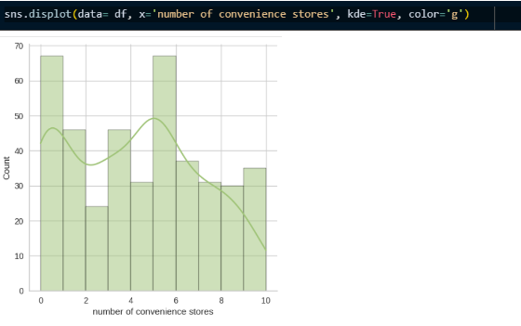

Slide 34
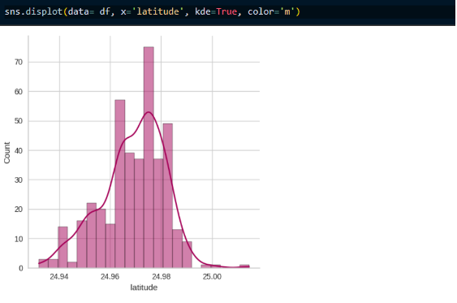

Slide 35
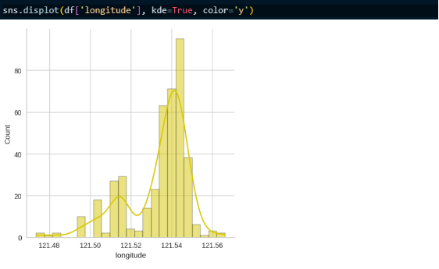

Slide 36
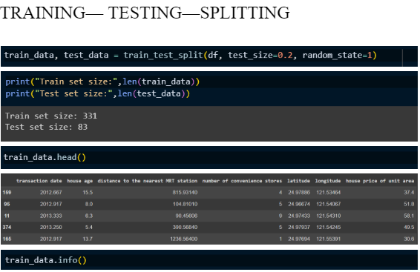

Slide 37
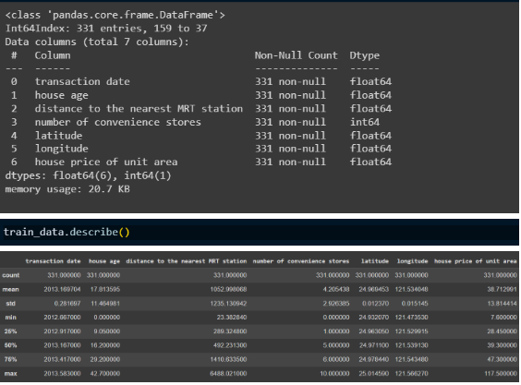

Slide 38
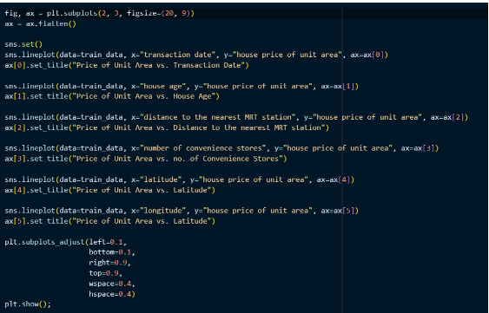

Slide 39
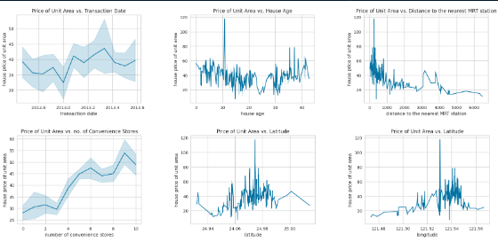

Slide 40
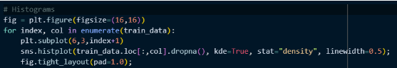

Slide 41
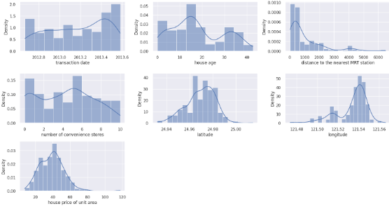

Slide 42
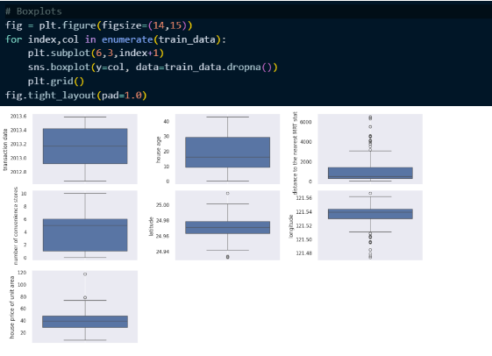

Slide 43
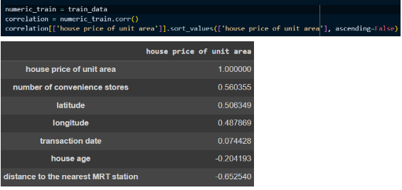

Slide 44
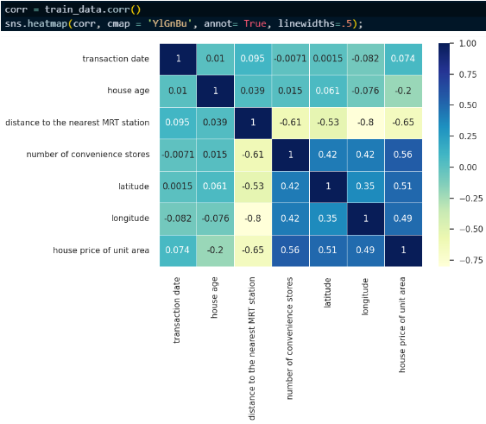

Slide 45
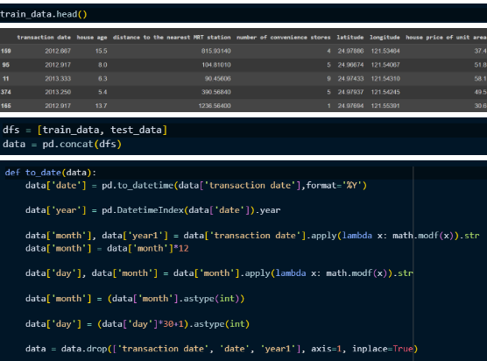

Slide 46
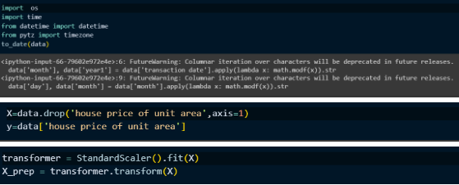

Slide 47
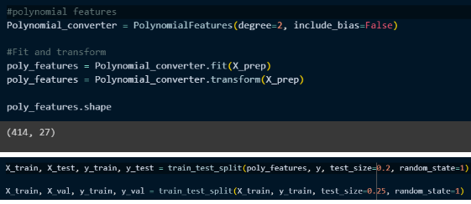

Slide 48
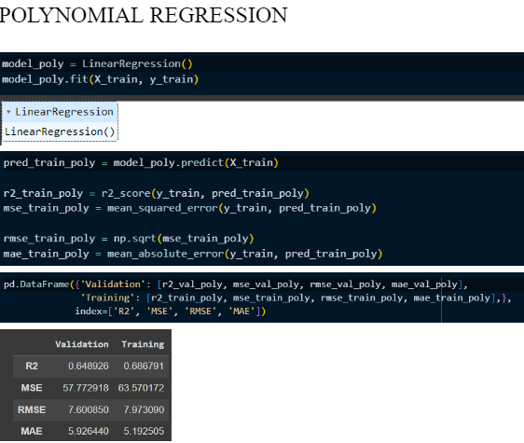

Slide 49


Slide 50


Slide 51


Slide 52


Slide 53


Slide 54


Slide 55


Slide 56


Slide 57


Slide 58


Slide 59


Slide 60


Slide 61


Slide 62


Slide 63


Slide 64


Slide 65


Slide 66


Slide 67


Slide 68


Slide 69


Slide 70


Slide 71


Slide 72


Slide 73


Slide 74


Slide 75


Slide 76


“QUOTE”
CONCLUSION
To sum up, the goal of this work has been to construct a reliable forecast model for housing costs by thoroughly analyzing an asset prognosis collection. Important insights regarding the variables impacting property values and their associations are being obtained via preliminary data analysis using artificial intelligence approaches. Based on pertinent features, the built predictive algorithm accurately estimates property prices with promising outcomes. Through the utilization of the above framework, real estate sector participants can make better-informed choices about investment decisions and pricing tactics, which in turn leads to more effective and translucent markets for properties.

Slide 77


